Slide 1
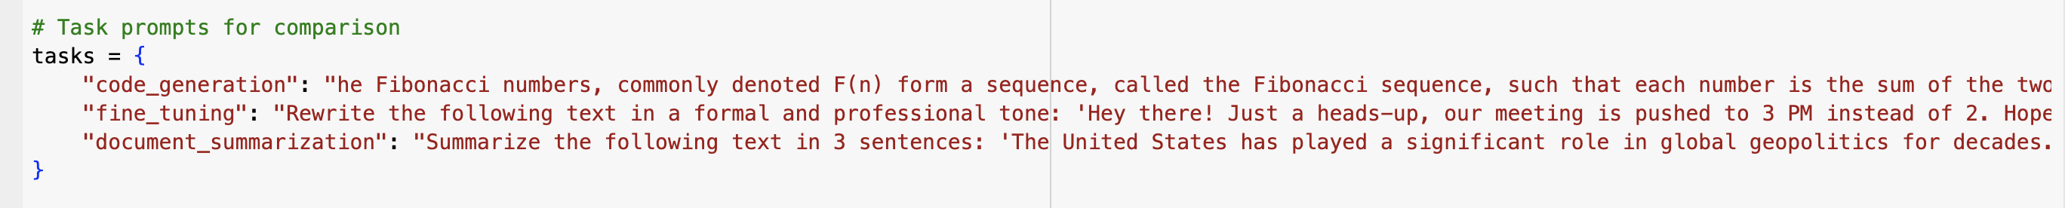
ChatGPT vs. DeepSeek AI: A Performance Comparison
Comparing Code Generation, Fine-Tuning, and Document Summarization
Sathwik Reddy Chelemela

Slide 2
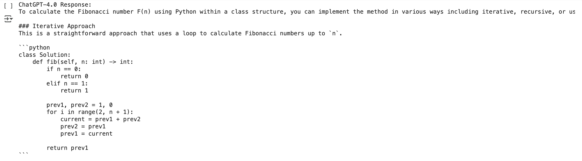
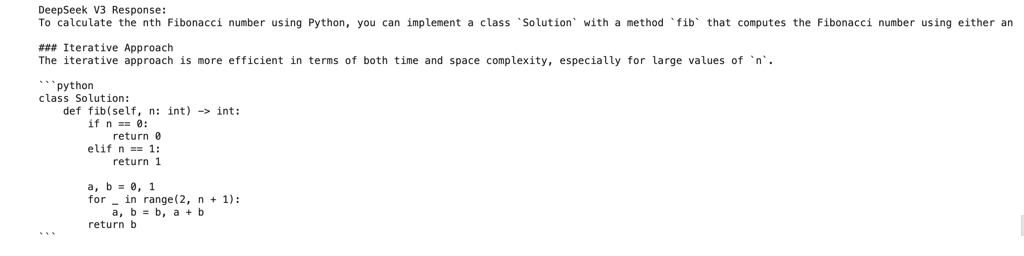
Code Generation: Task Overview
Using API from OpenAI (ChatGPT 4.0) and Together AI (Deepseek V3) and generated answers
Task: Fibonacci Number Implementation (LeetCode 509)
Evaluating AI models based on efficiency, runtime, and accuracy in generating code solutions.

Slide 3
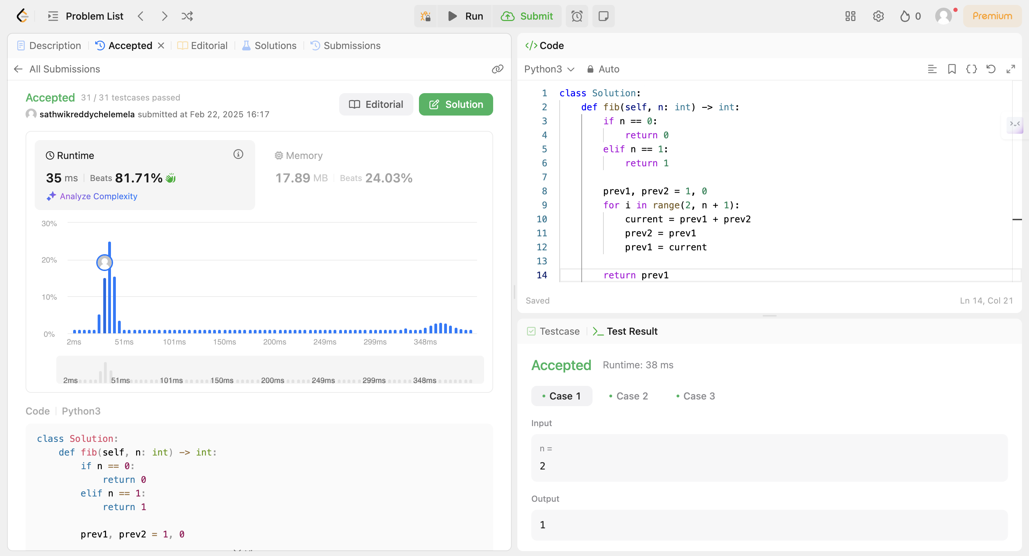
Testing ChatGPT Code Solution
- Used an optimized iterative approach.
- Time Complexity: O(n), Space Complexity: O(1).
- Efficient with low runtime and passed all test cases.

Slide 4
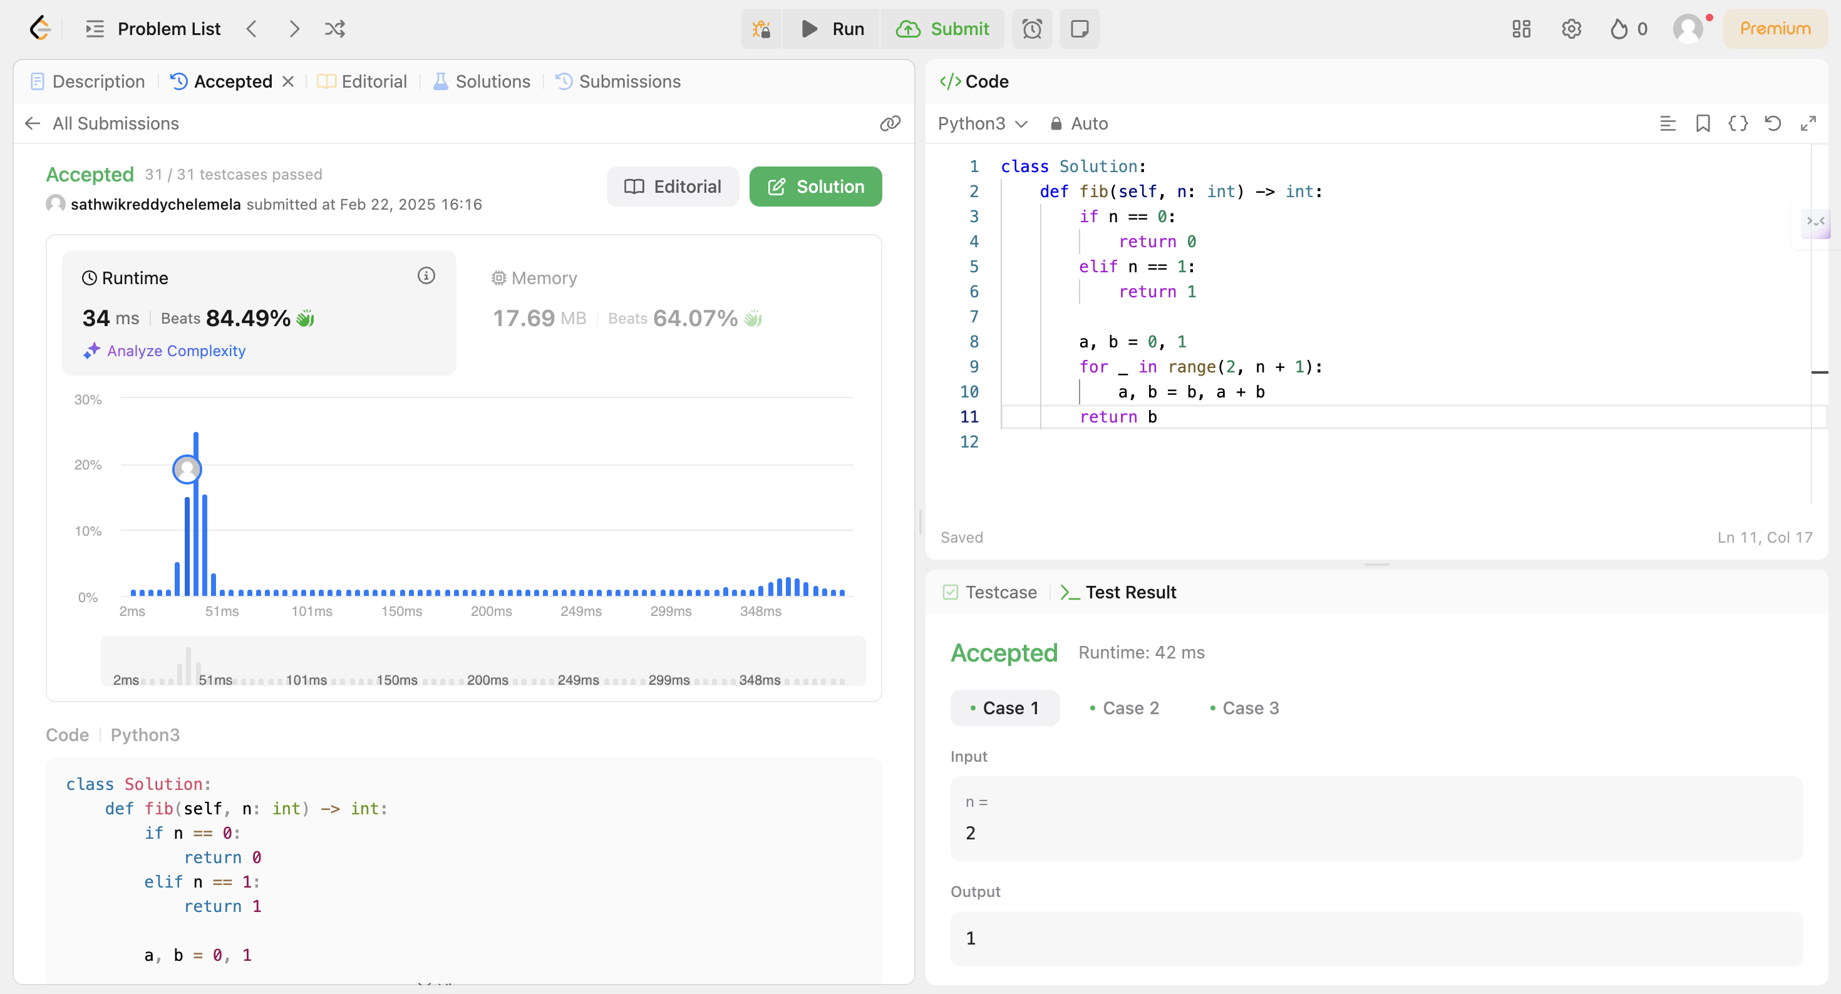
Testing DeepSeek Code Solution
- Also used an iterative approach.
- Slightly higher runtime.
- Less optimized variable handling.
Verdict: DeepSeek produced a more efficient solution.

Slide 5
Document Summarization: Task Overview
Task 1 : Summarizing an AI article from Harvard Business Review. (using ChatGPT and Deepseek)
Task 2 : Evaluating AI models using API on conciseness, logical flow, and key insight retention. ( in .ipynb code provided )

Slide 6
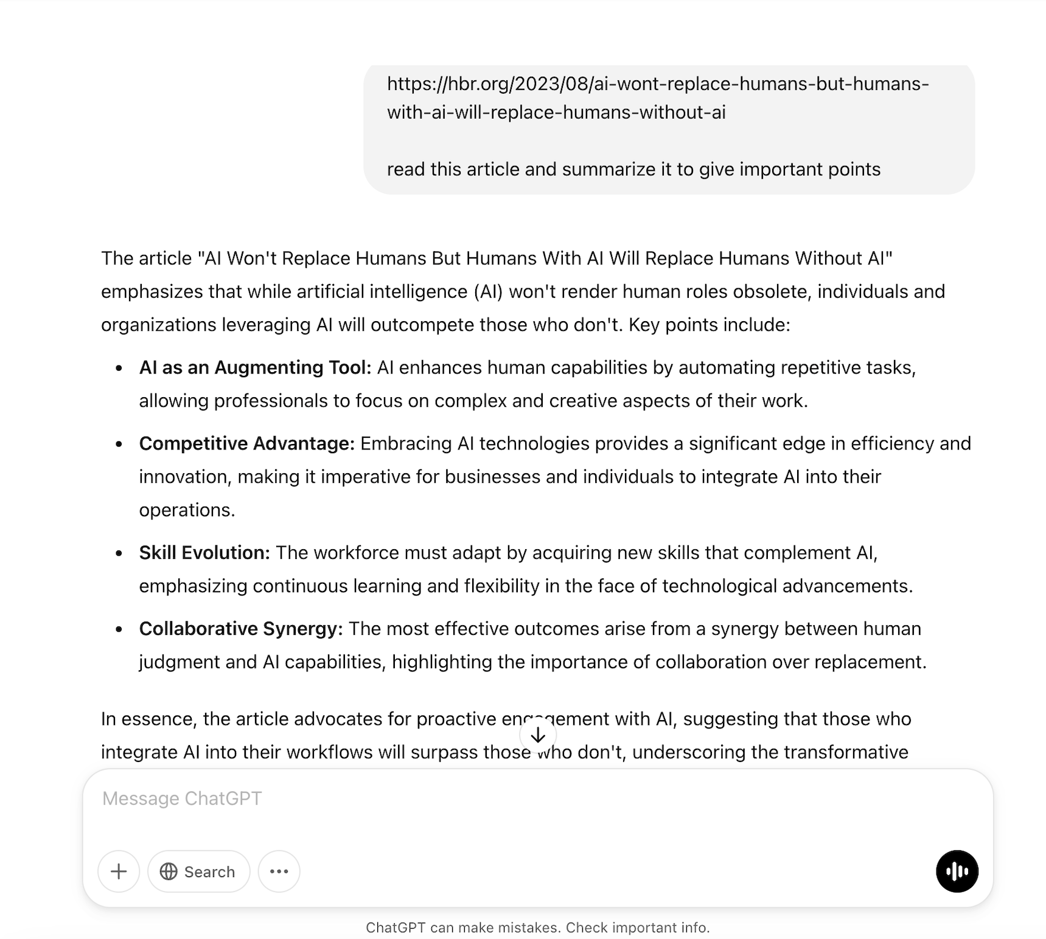
Task 1 :ChatGPT Document Summarization
ChatGPT provides a concise, structured summary emphasizing key points like augmentation, competitive advantage, skill evolution, and collaboration, making it easy to grasp the core message quickly.

Slide 7
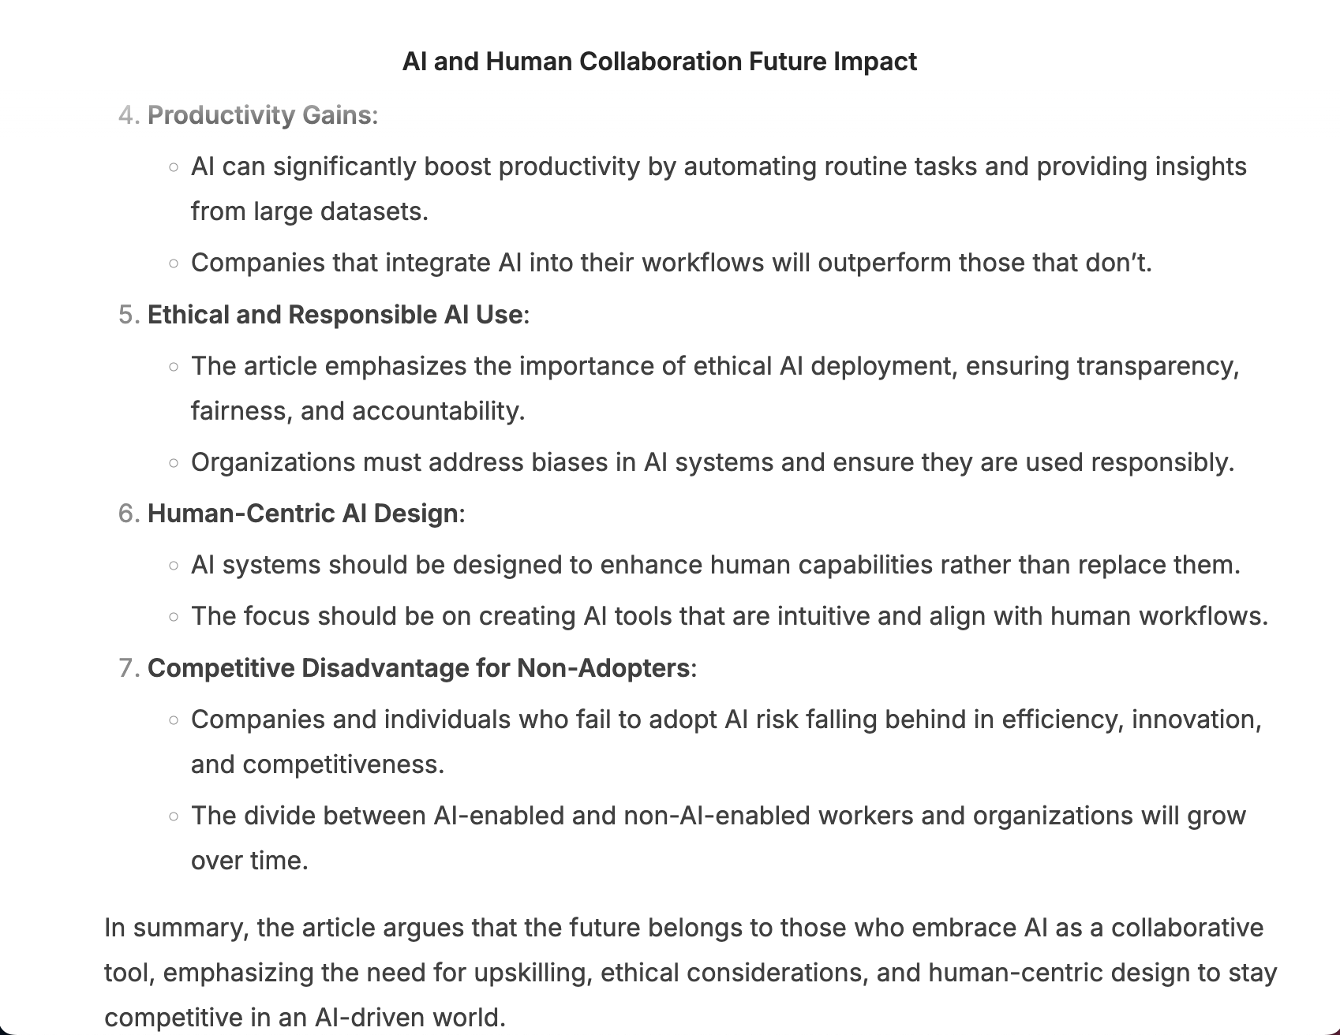
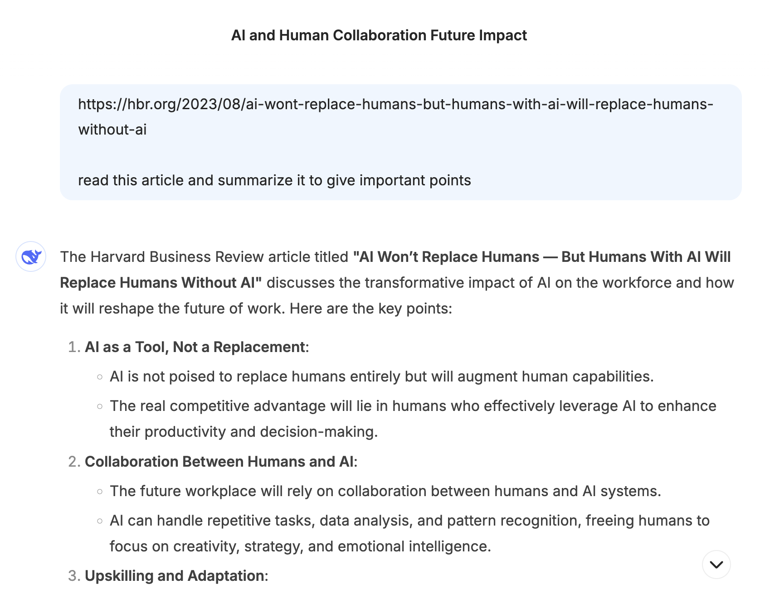
Task 1 :DeepSeek Document Summarization
DeepSeek AI, on the other hand, offers a more detailed breakdown, covering additional aspects such as ethical AI use, human-centric design, and competitive disadvantages for non-adopters, making it more comprehensive but slightly longer to read.

Slide 8
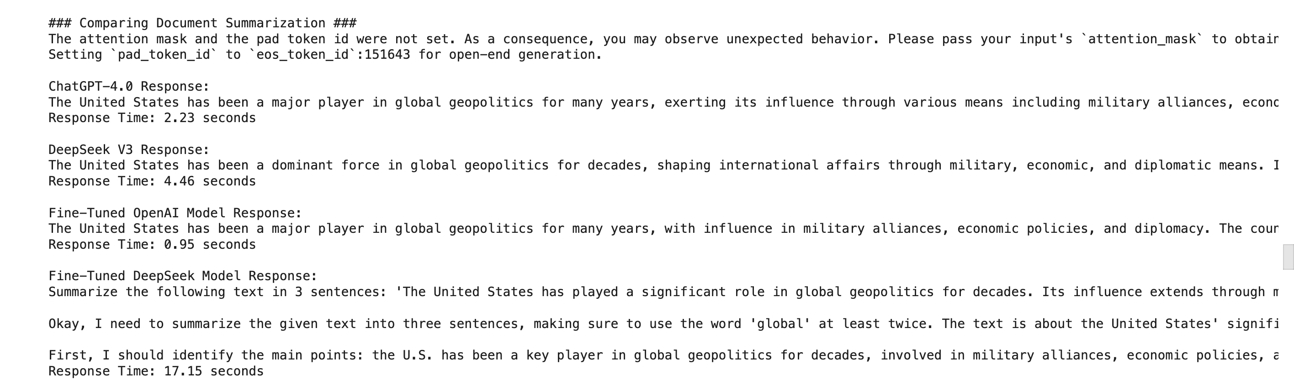
Task 2 : Evalution of outputs generated using API (.ipynb code provided) Prompt : Summarize the following text in 3 sentences: 'The United States has played a significant role in global geopolitics for decades. Its influence extends through military alliances, economic policies, and diplomatic efforts. The country has been involved in shaping international institutions, participating in peacekeeping missions, and leveraging economic sanctions to influence global events.

Slide 9
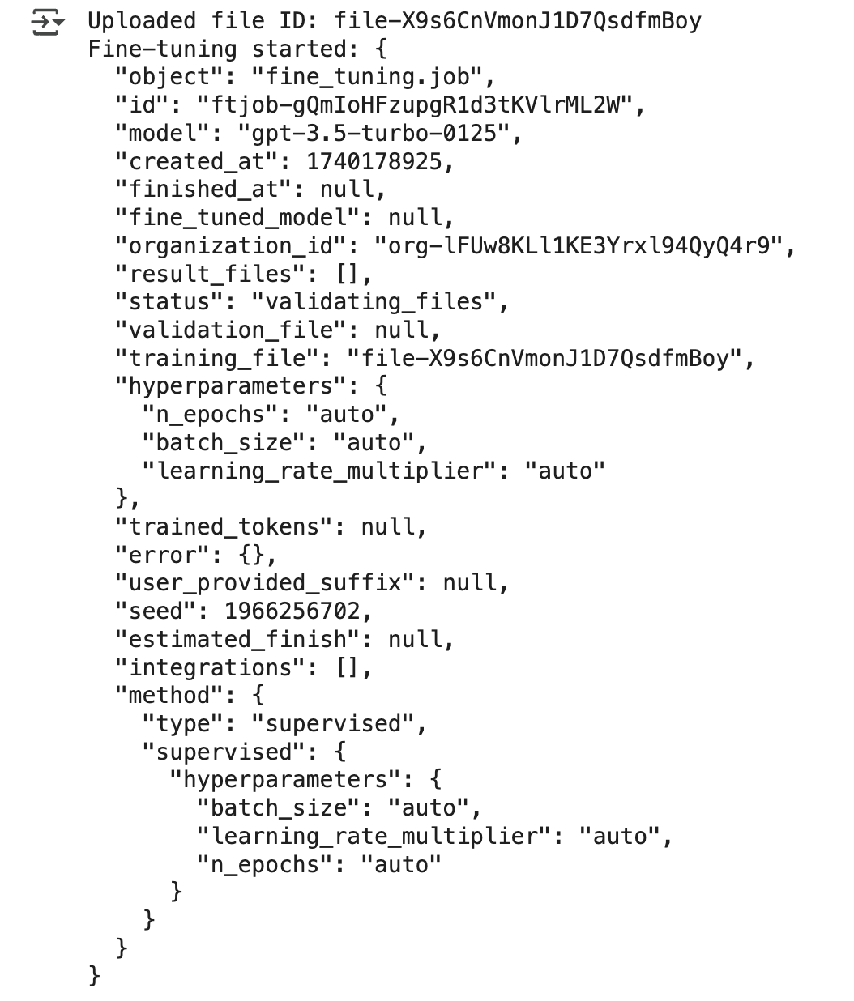
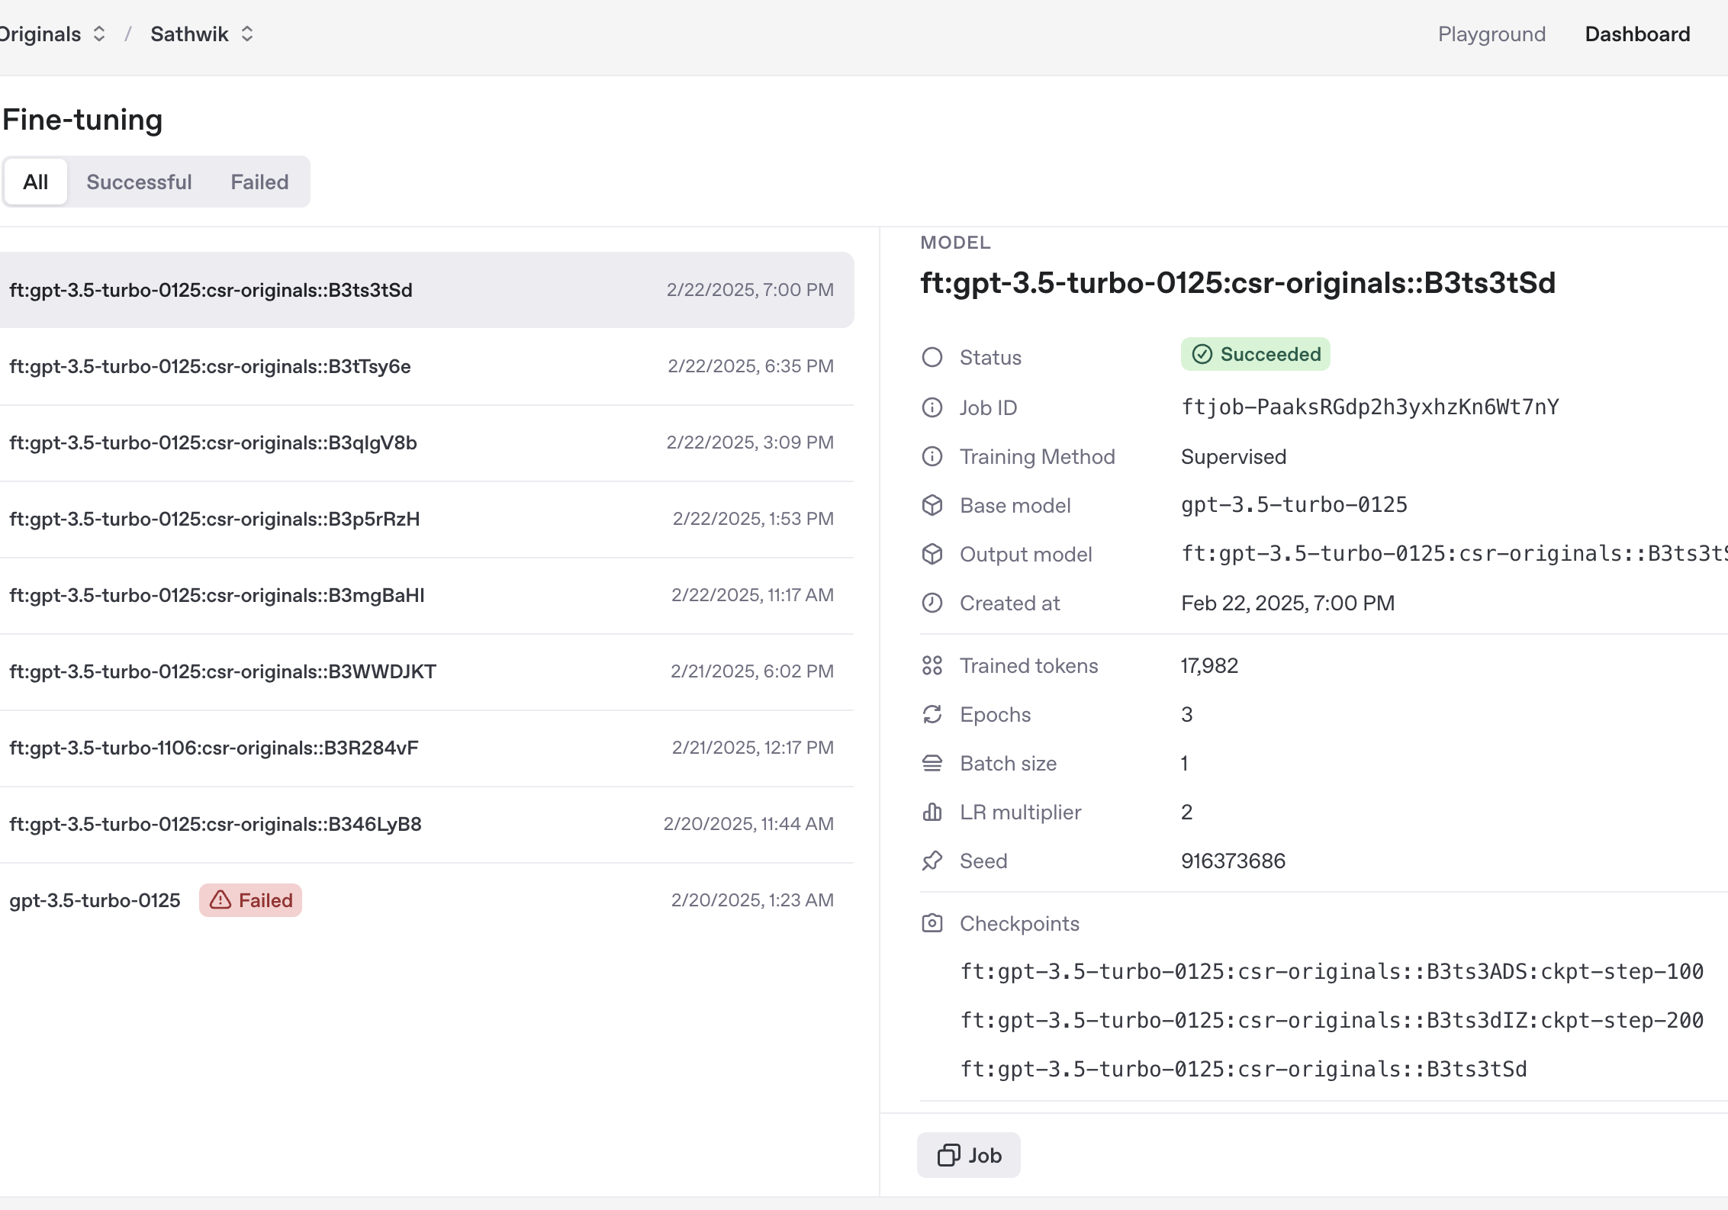
ChatGPT Fine-Tuning Performance
Used OpenAI's fine-tuning API.
Adapted well to structured training data.
Produced empathetic and relevant responses.

Slide 10
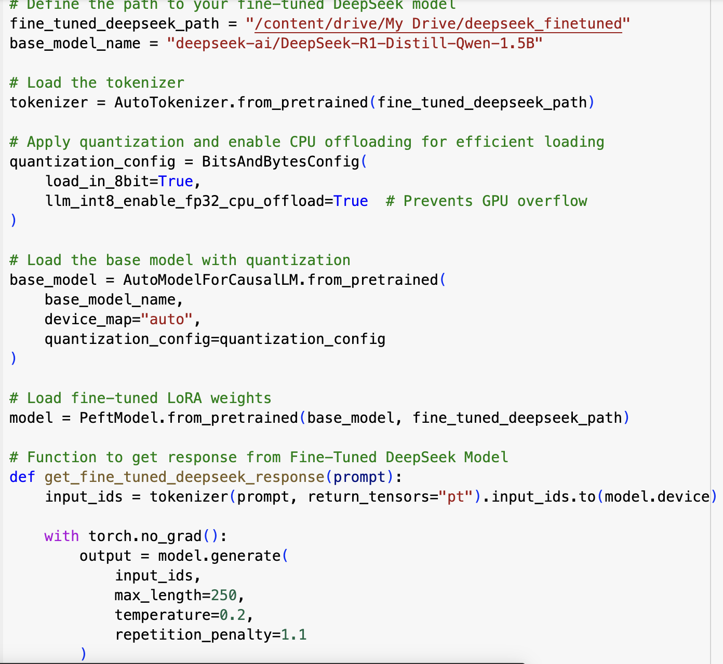
DeepSeek Fine-Tuning Performance
additional prompting
Detailed Response
Breakdown the problem into steps

Slide 11
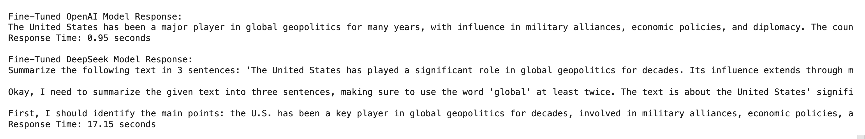
Fine-Tuning: Task 1 Result (.ipynb )
Prompt : Summarize the following text in 3 sentences: 'The United States has played a significant role in global geopolitics for decades. Its influence extends through military alliances, economic policies, and diplomatic efforts. The country has been involved in shaping international institutions, participating in peacekeeping missions, and leveraging economic sanctions to influence global events.
Task: Training a custom AI model built using Training Data Json file.

Slide 12
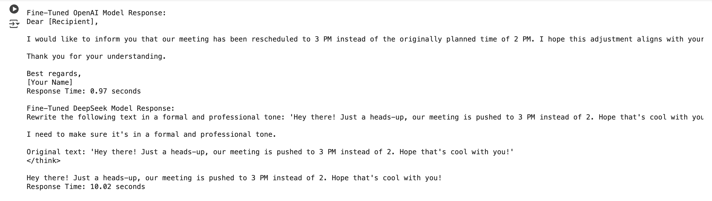
Fine-Tuning: Task 2 Result (.ipynb)
Prompt : Rewrite the following text in a formal and professional tone: 'Hey there! Just a heads-up, our meeting is pushed to 3 PM instead of 2. Hope that's cool with you!

Slide 13
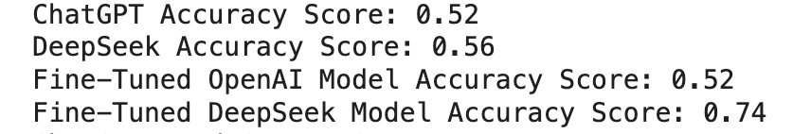
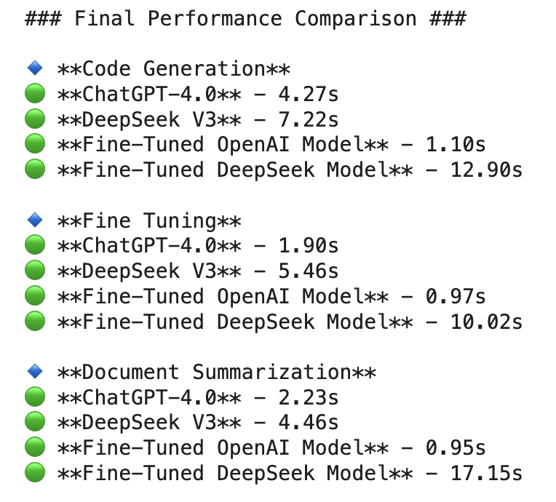
Final Verdict: Who Performed Better?
Code Generation:
ChatGPT (Better optimization)
DeepSeek (Better Efficiency)
Fine-Tuning:
ChatGPT (Stronger adaptability and response quality)
DeepSeek (Step by step detailed breakdown)
Document Summarization:
ChatGPT (More structured and logical summaries)
DeepSeek (More detailed)

